Slide 1
Task 1.4 Information Architecture
Submitted by – Minal Bombatkar
21 March 2019

Slide 2
TASK ANALYSIS 1
TASK ANALYSIS 2
Entry point: User types and On boarding of the app
Entry point: Open application
Success Criteria: Able to understand the meaning of the word with it’s definition. It will help to pronounce the word in correct manner.
Success Criteria: Memorise the words using Flash cards
Login screen
a. If existing member, input credentials
b. If new member, select “create account”
Input information in Registration form
3. Home screen
Select feature flash cards
a. Existing sets
5. Create new sets
i. Select “new sets” button
ii. Input sets name
Iii Add Term and definition
iv. Select “done” when finished editing.
6. Start learning
7. Begin flash cards
a. Tap to flip for Term, swipe for definition
8. Shows result
9. Repeat learning phase if want
10. Exit
Login screen
a. If existing member, input credentials
b. If new member, select “create account”
Input information in Registration form
3. Home screen
4. Select Dictionary feature
a. Search for word b. Search by alphabet
5. Select the word
6. Start learning
7. Review
Add to Favourite
Save to library
b. Activate the pronunciation
8. Repeat learning phase if want
9. Exit

Slide 3
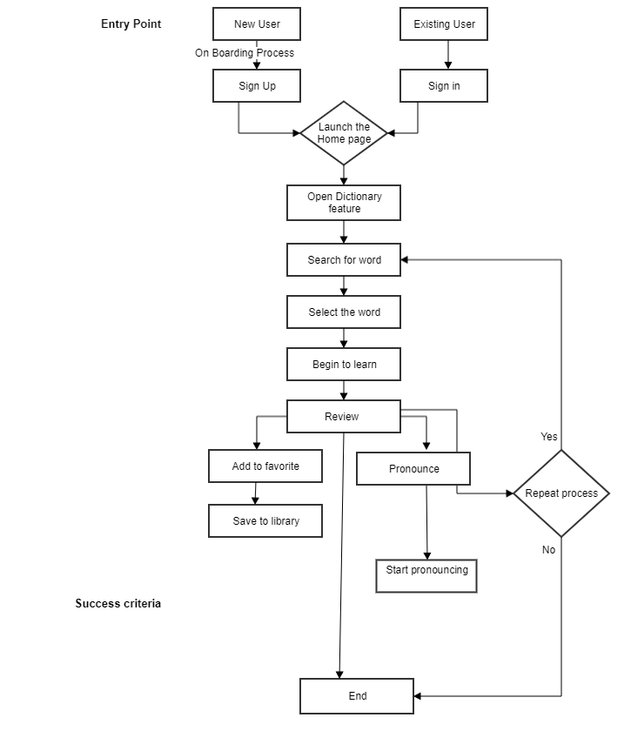

Slide 4
